Slide 1
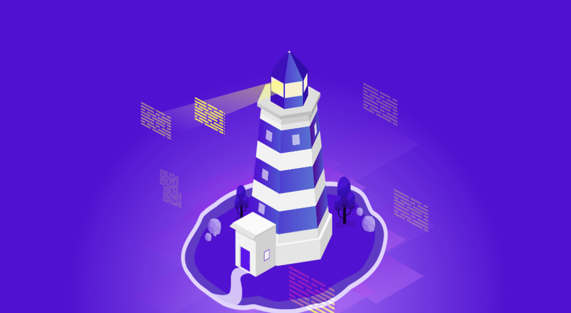
Welcome to join Harbor Community Conference Call
06:00-06:30 AM (PDT) /
21:00-21:30 (Beijing Time)
2019/12/18 Wednesday
https://zoom.us/j/734959521
Twitter
Maillist
Slack (slack.cncf.io)
@project_harbor
harbor-users@lists.cncf.io
#harbor
#harbor-dev
harbor-dev@lists.cncf.io

Slide 2

Release V1.8 – Prepare script refactor
Meeting Host
Steven Zou (github:steven-zou)
Harbor maintainer

Slide 3
Agenda
- More about the next release(V2.0) [5 mins] - Alex Xu
- Enable GitHub Action to drive the Harbor CI process [10 mins] - ZiMing Zhang
- Harbor + FATE use case sharing [10 mins] - Henry Zhang
- Free discussions: Any Harbor community and project related questions [5 mins]

Slide 4
More about next release (V2.0)
Alex Xu
Product Management, VMware Harbor team

Slide 5
Release V2.0
OCI support - extend support for other artifacts beyond container images and helm charts
tag deletion - allow deleting a single tag without deleting other tags pointed to by the same manifest
online non-blocking GC - non-blocking GC mechanism so users can push and pull images from Harbor registry while garbage collection is ongoing
P2P with Dragonfly / Kraken - leverage p2p tools to better distribute images to other hosts
Webhooks 2.0 - new webhooks for replication, tag deletion, tag retention
Notary v2 - harbor team tracking progress being made on notary v2 geared towards a multi-registry world

Slide 6
Enable GitHub Action to drive the Harbor CI
ZiMing Zhang
Harbor Contributor, VMware Harbor team

Slide 7
Harbor + FATE
Henry Zhang
Harbor Founder and Maintainer

Slide 8
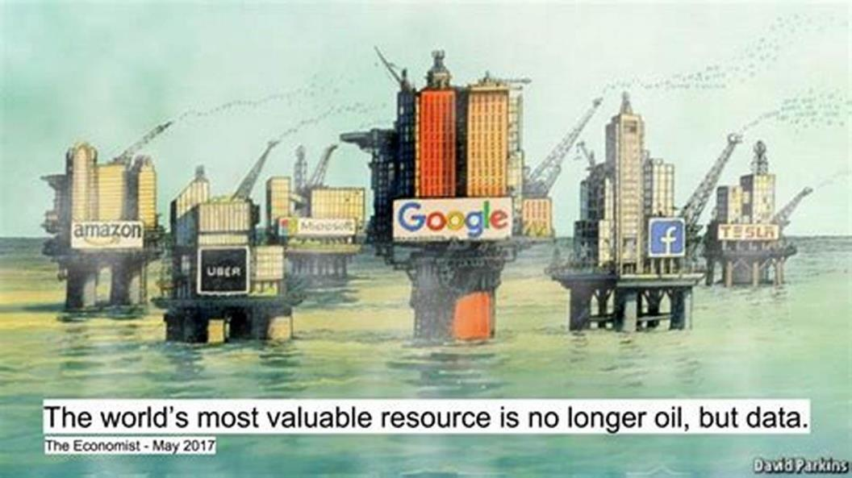

The Secret of AI’s Success: Computing Power and Big Data
The New Rich
Notes:
The success of AI lies in two important things: computing power, and data. Many people think data to AI is as important as gas to car. If you have large amount of good data, even though your algorithm is not so good, you can still create a useful model.

Slide 9

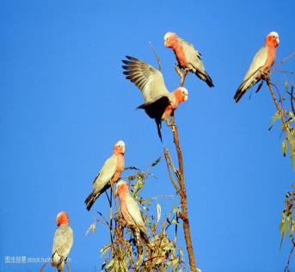
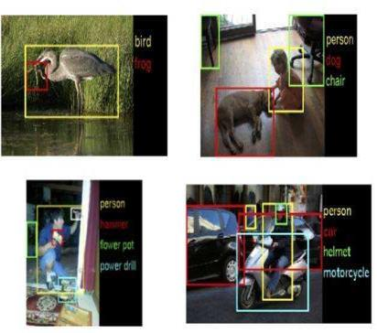
Challenges to AI: small data set and fragmented data (1)
Enterprise A
Enterprise B
Security in data sharing
Lack of labeled data
Segregated datasets
Over 80% of enterprises have information silos!

Slide 10


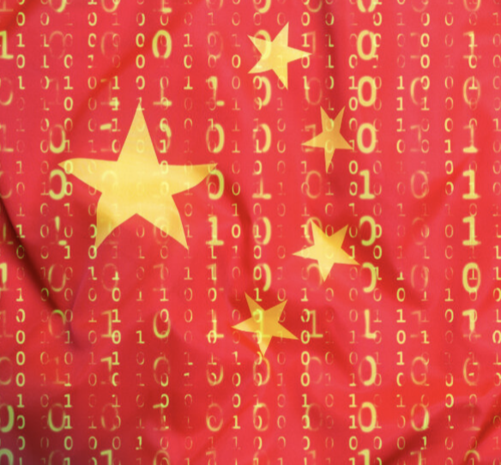
Challenges to AI: Data Privacy and Confidentiality (2)
General Data Protection Regulation (GDPR)
California Consumer Privacy Act (CCPA)
China’s Cyber Security Law

Slide 11
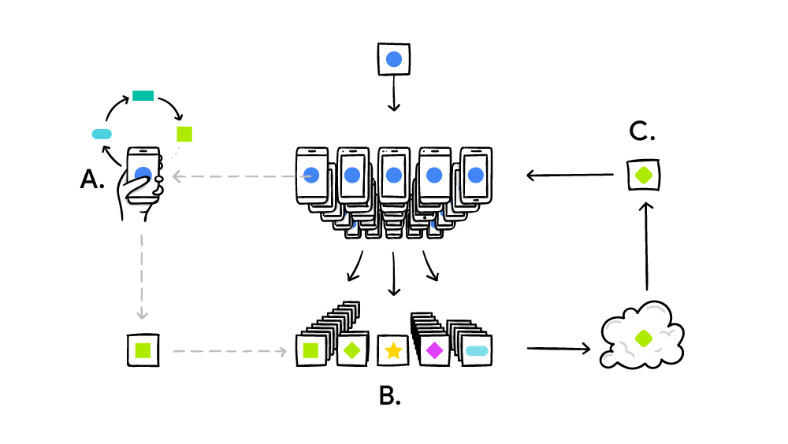
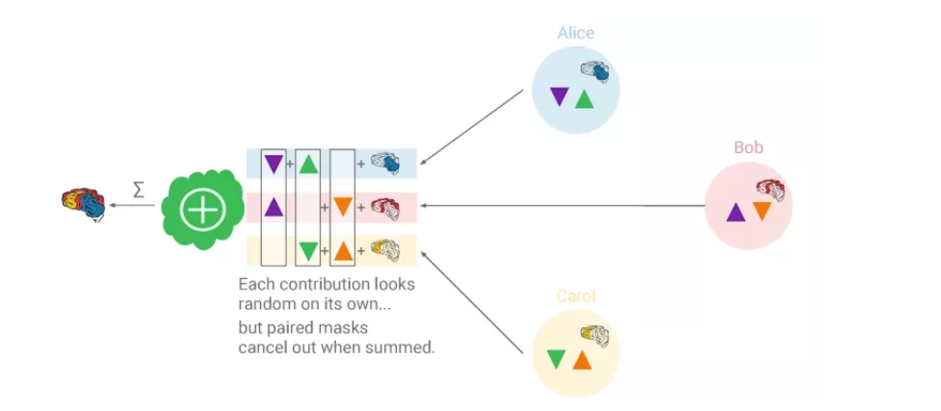
Introducing Federated Learning
H. Brendan McMahan et al, Communication-Efficient Learning of Deep Networks from Decentralized Data, Google, 2017
Bonawitz K, Ivanov V, Kreuter B, et al. Practical secure aggregation for privacy-preserving machine learning, Google, 2017

Slide 12

General Federated Learning Catalog
Horizontal Federated Learning
Data A
Federated Transfer Learning
Sample
Data B
Data A
Label
Samples
Features
Data B
Vertical Federated Learning
Label
Data A
Features
Sample
Data B
Label
Features

Slide 13
Build Privacy Preserving Model between Organizations
Objective:
➢ Party (A) and Party (B) co-build a FL model
Assumptions: ➢ Only one party has label Y ➢ Neither party wants to expose their X or Y
Challenges:
➢ Parties cannot exchange raw data
Goals: ➢ Data privacy for both parties
➢ model is LOSSLESS
ID | X1 | X2 | X3
U1 | 9 | 8000 | A
U2 | 4 | 5000 | C
U3 | 2 | 3500 | C
U4 | 10 | 10000 | A
U5 | 5 | 7500 | B
U6 | 5 | 7500 | A
U7 | 8 | 8000 | B
ID | X4 | X5 | Y
U1 | 600 | 600 | Y
U2 | 550 | 500 | N
U3 | 520 | 500 | N
U4 | 600 | 600 | Y
U8 | 600 | 600 | N
U9 | 520 | 500 | N
U10 | 600 | 600 | Y
Retailer A
Bank B

Slide 14
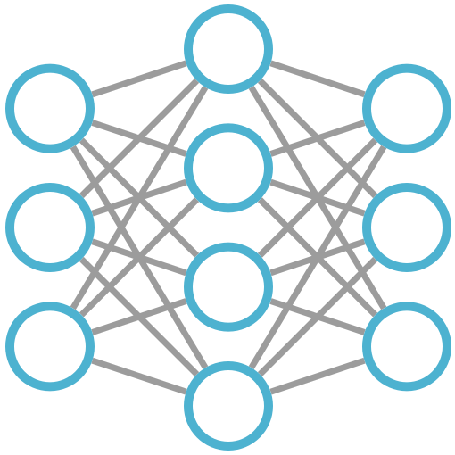







Vertical Federated Learning
Sub-Model A
Sub-Model B
Cross-Bank
Federation
Recall +15%
ISP-Bank
Federation
Accuracy +12%
Model Parameter Exchange
FML
Agent A
FML
Agent B
ISP-Retailors
Federation
Cost -25%
Encrypted Sample Alignment
ISP-Insurance
Federation
Profit +150%
Database A
Database B
MPC + HE
Qiang Yang, Yang Liu, Tianjian Chen, and Yongxin Tong. 2018. Federated Learning. Communications of The CCF，14, 11 (2018), 49–55

Slide 15


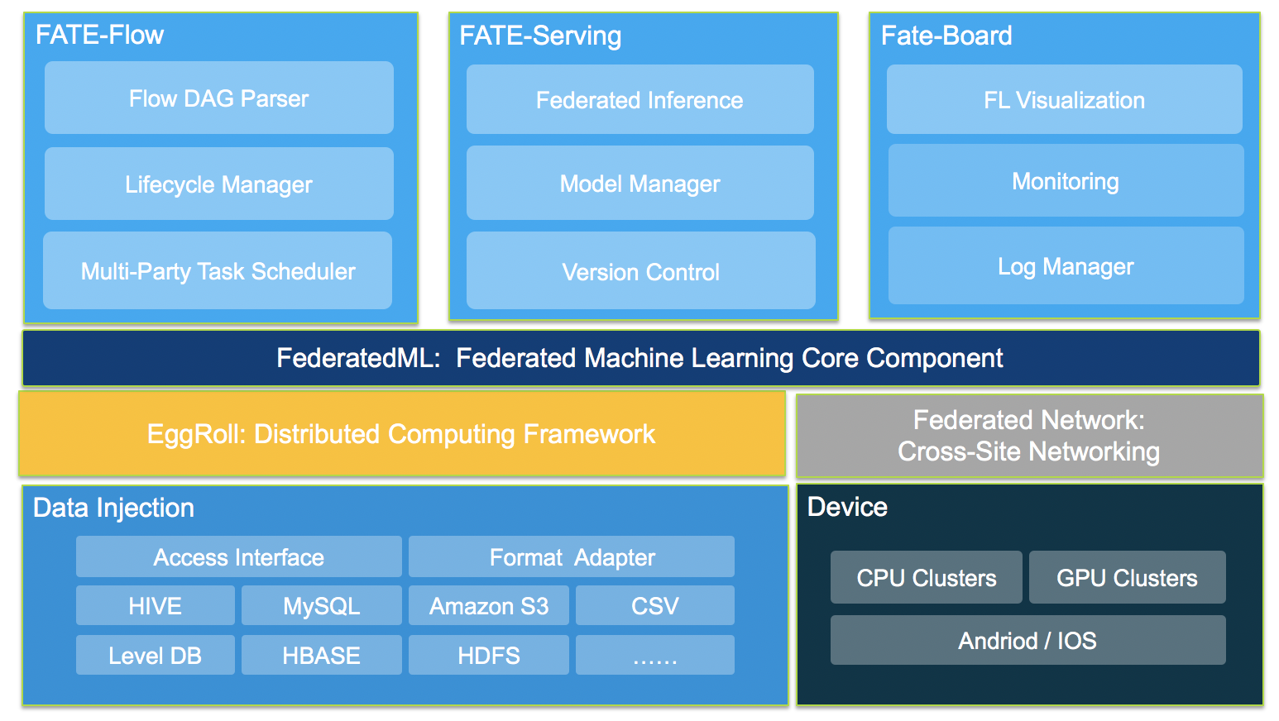
FATE : Federated AI Technology Enabler
Vision
Industry level federated learning framework with out-of-box usability
Enable data collaboration with data protection regulation compliance
Background
Initiated by WeBank, the first internet bank in China
Donated to Linux Foundation in June 2019
https://github.com/FederatedAI/FATE
https://FedAI.org
VMware OSS contribution
Deployment using container and Kubernetes
Partnership with community members

Slide 16
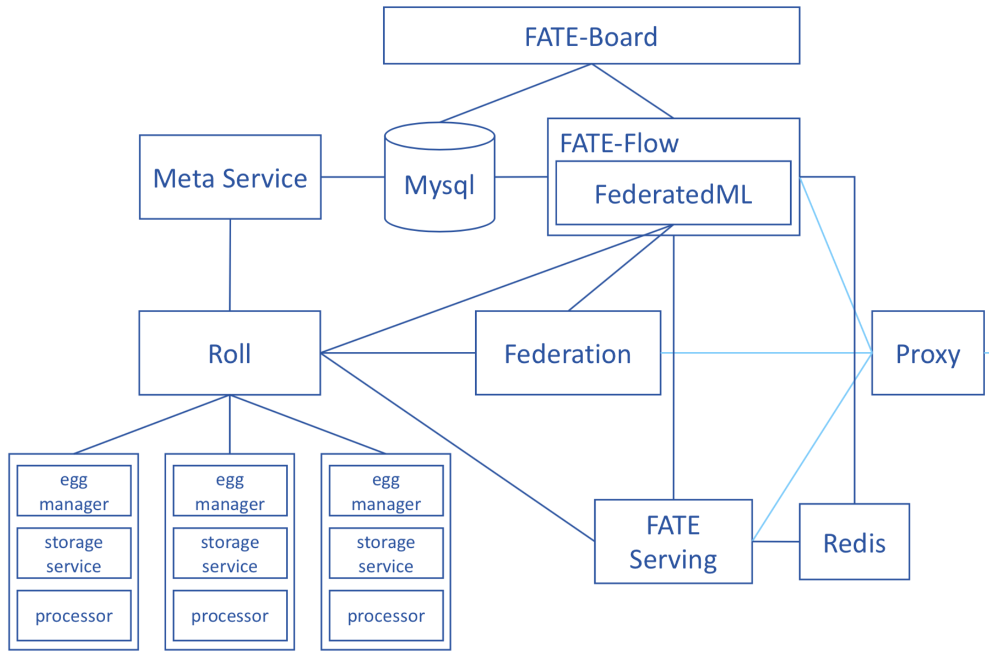
FATE deployment (single party)
Distributed system, dependency of various packages
At least one FATE instance for a party
Interaction btw different parties
The need to scale some components

Slide 17
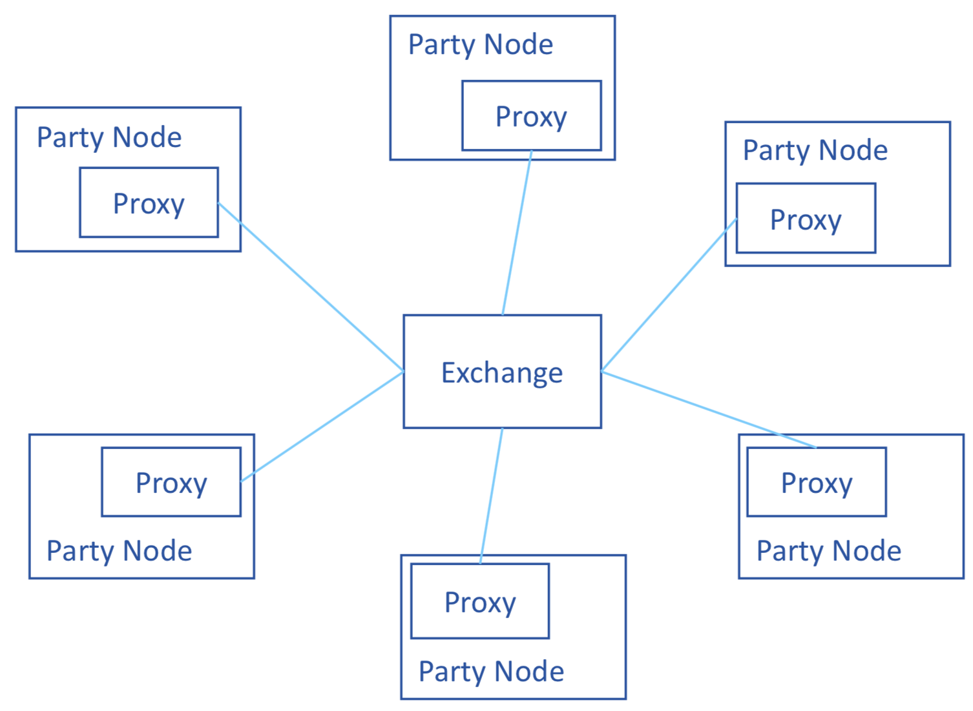
FATE deployment of multiple parties

Slide 18


KubeFATE: Harbor integration with FATE
Containerize all FATE components
No need to compile from source code
Docker-compose for single node deployment
Helm Chart for Kubernetes deployment (cluster)
Harbor manages container images and Helm charts
Image replication from Docker Hub or other registry）
Offline installation
Reduce complexity of operation
Scheduled image replication
Offline image and
Helm Chart import
distribution
Kubernetes
Federation
Proxy
Meta service
Roll
Egg x n
Serving
Board
Fate-Flow
Master
Worker 1
Worker 2
Worker 3 x n
Worker 4
Worker 5

Slide 19
FATE and useful info
Website: https://www.fedai.org/
Contact: contact@fedai.org
Github:
github.com/FederatedAI/FATE
github.com/FederatedAI/KubeFATE

Slide 20
Topics?
Any topics to discuss here?

Slide 21
Meeting minutes
Meeting is recorded and the recording link will be updated to the meeting schedule doc later: https://github.com/goharbor/community/blob/master/MEETING_SCHEDULE.md
The meeting slides will be uploaded to the community repo https://github.com/goharbor/community and put under the ‘conf-calls’ folder.

